Slide 1
Atomic Force Microscopy
Alexandre Dazzi, Institut de Chimie Physique
alexandre.dazzi@universite-paris-saclay.fr

Slide 2
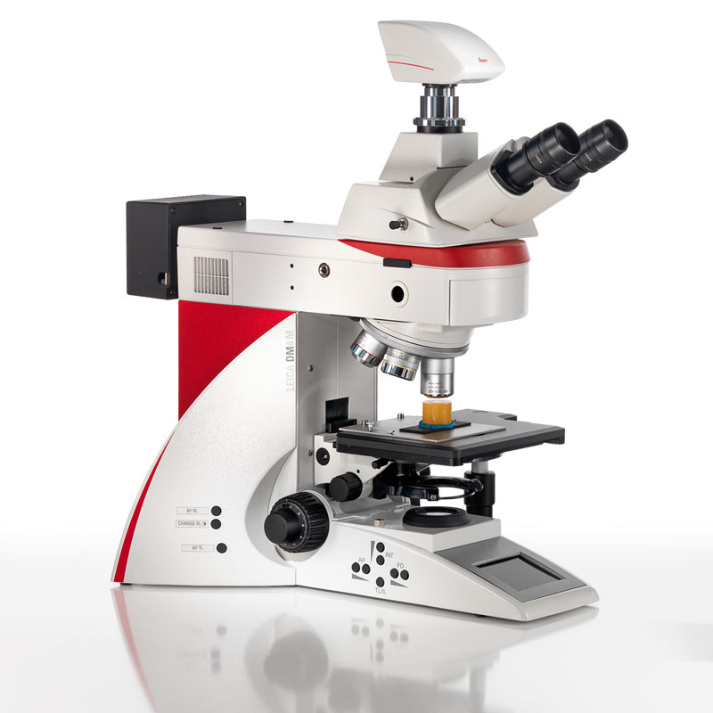
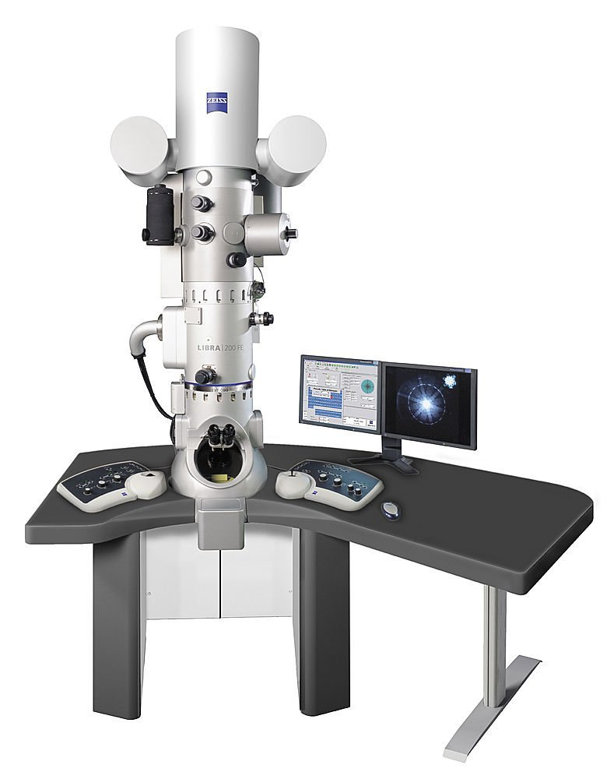
I.Introduction
80’s, strong willing to manipulate and observe nanometric objects
Optical Microscopy
Electron Microscopy
res ≈ 300 nm
res ≈ 0.1 nm

Slide 3
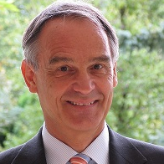
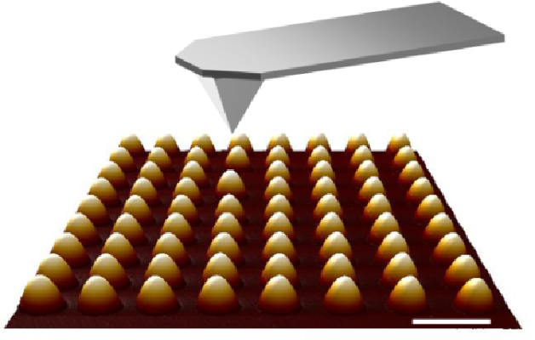
I. Introduction
« Feeling is better than seeing »
or the born of nanotechnology
Gerd Binnig
1985 Atomic Force Microscope
(Physics Nobel Prize 1986)
Silicon tip to palpate the surface.
Cantilever to move the tip.
No constraint on the surface nature

Slide 4
II. Tip-Surface interaction
II. Tip-surface interaction
How to describe the tip-surface interaction?
cantilever
tip
F_{int}
R_{tip}
sample
F_{int}
sample

Slide 5
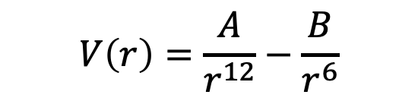
II. Tip-Surface interaction
A) Atom-atom interaction
Lennard-Jones potential describes the interaction between atoms or small molecules.
$$V\left(r\right)=\frac{A}{r^{12}}−\frac{B}{r^{6}}$$
A,B constant related to nature of atoms and r distance between atoms
Repulsive interactions
Attractive interactions
(Van der Waals)
M1
r
M2

Slide 6
II. Tip-Surface interaction
Lennard-Jones Potential for Si-Si
repulsive region
Attractive region

Slide 7
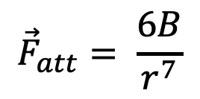
II. Tip-Surface interaction
B) Tip-surface interaction
B.1) Attractives forces
$${\vec{F}}_{att}= \frac{6B}{r^{7}}$$
F_{att}
R_{tip}
R_{tip}
(Van der Waals)
F_{int}
F_{int}
sample
sample

Slide 8
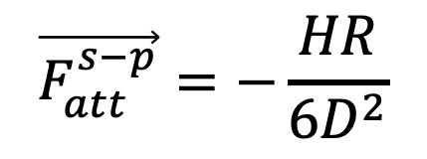
II. Tip-Surface interaction
B.1) Attractives forces for a sphere-plane interaction
R
$$\vec{F_{att}^{s−p}}=−\frac{HR}{6D^{2}}$$
F_{att}
H Hamaker constant, R radius of the tip,
D distance bertween tip and sample surface
D

Slide 9
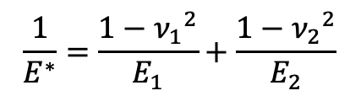
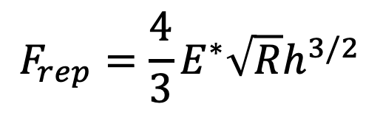
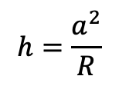
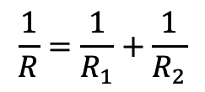
II. Tip-Surface interaction
B.2) Repulsive forces for a sphere-plane interaction
B.2.1) Hertz contact
$$F_{rep}=\frac{4}{3}E^{∗}\sqrt{R}h^{3/2}$$
R₁
h indentation
a radius of contact area
R radius of the sphere
E Young modulus
ν Poisson coefficient
F_{rep}
Surface of contact
$$\frac{1}{E^{∗}}=\frac{1−{ν_{1}}^{2}}{E_{1}}+\frac{1−{ν_{2}}^{2}}{E_{2}}$$
h
a
$$\frac{1}{R}=\frac{1}{R_{1}}+\frac{1}{R_{2}}$$
$$h=\frac{a^{2}}{R}$$
R₂

Slide 10
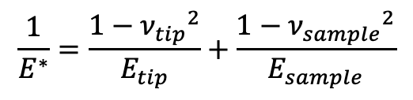
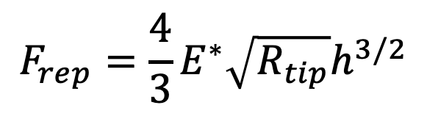
II. Tip-Surface interaction
B.2) Repulsive forces for a sphere-plane interaction
B.2.2) Sphere-plane
D
$$F_{rep}=\frac{4}{3}E^{∗}\sqrt{R_{tip}}h^{3/2}$$
E_{tip}
R_{tip}
$$\frac{1}{E^{∗}}=\frac{1−{ν_{tip}}^{2}}{E_{tip}}+\frac{1−{ν_{sample}}^{2}}{E_{sample}}$$
h
E_{sample}

Slide 11
II. Tip-Surface interaction
B.2) Repulsive forces for a sphere-plane interaction
B.2.2) Sphere-plane
How to define the distance of contact ?
D
d_{c}
0
0
d_{c}=0.165 nm

Slide 12
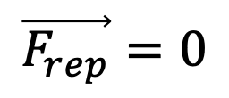
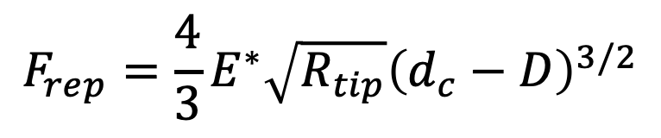
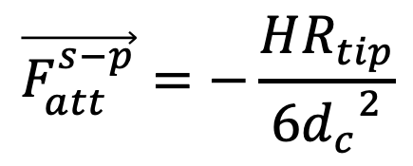
II. Tip-Surface interaction
B.2) Repulsive forces for a sphere-plane interaction
B.2.2) Sphere-plane
D
$$F_{rep}=\frac{4}{3}E^{∗}\sqrt{R_{tip}}{\left(d_{c}−D\right)}^{3/2}$$
E_{tip}
R_{tip}
Where D<d_{c}
(only true in contact)
d_{c}
h
0
In D=dc,
$$\vec{F_{rep}}=0$$
E_{sample}
$$\vec{F_{att}^{s−p}}=−\frac{HR_{tip}}{6{d_{c}}^{2}}$$
but

Slide 13
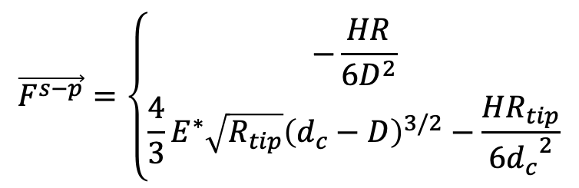


II. Tip-Surface interaction
B.3) Sphere-plane interaction force
z
R_{tip}
$$\vec{F^{s−p}}=\left\{\begin{aligned}−\frac{HR}{6D^{2}} \\ \frac{4}{3}E^{∗}\sqrt{R_{tip}}{\left(d_{c}−D\right)}^{3/2}−\frac{HR_{tip}}{6{d_{c}}^{2}}\end{aligned}\right.$$
E_{tip}
$$\vec{u_{z}}$$
If D>d_{c}
$$\vec{u_{z}}$$
If D≤d_{c}
D
$$\frac{1}{E^{∗}}=\frac{1−{ν_{tip}}^{2}}{E_{tip}}+\frac{1−{ν_{sample}}^{2}}{E_{sample}}$$
F^{s-p}
d_{c}
0
E_{sample}
DMT model (Derjagin-Muller-Toporov)

Slide 14
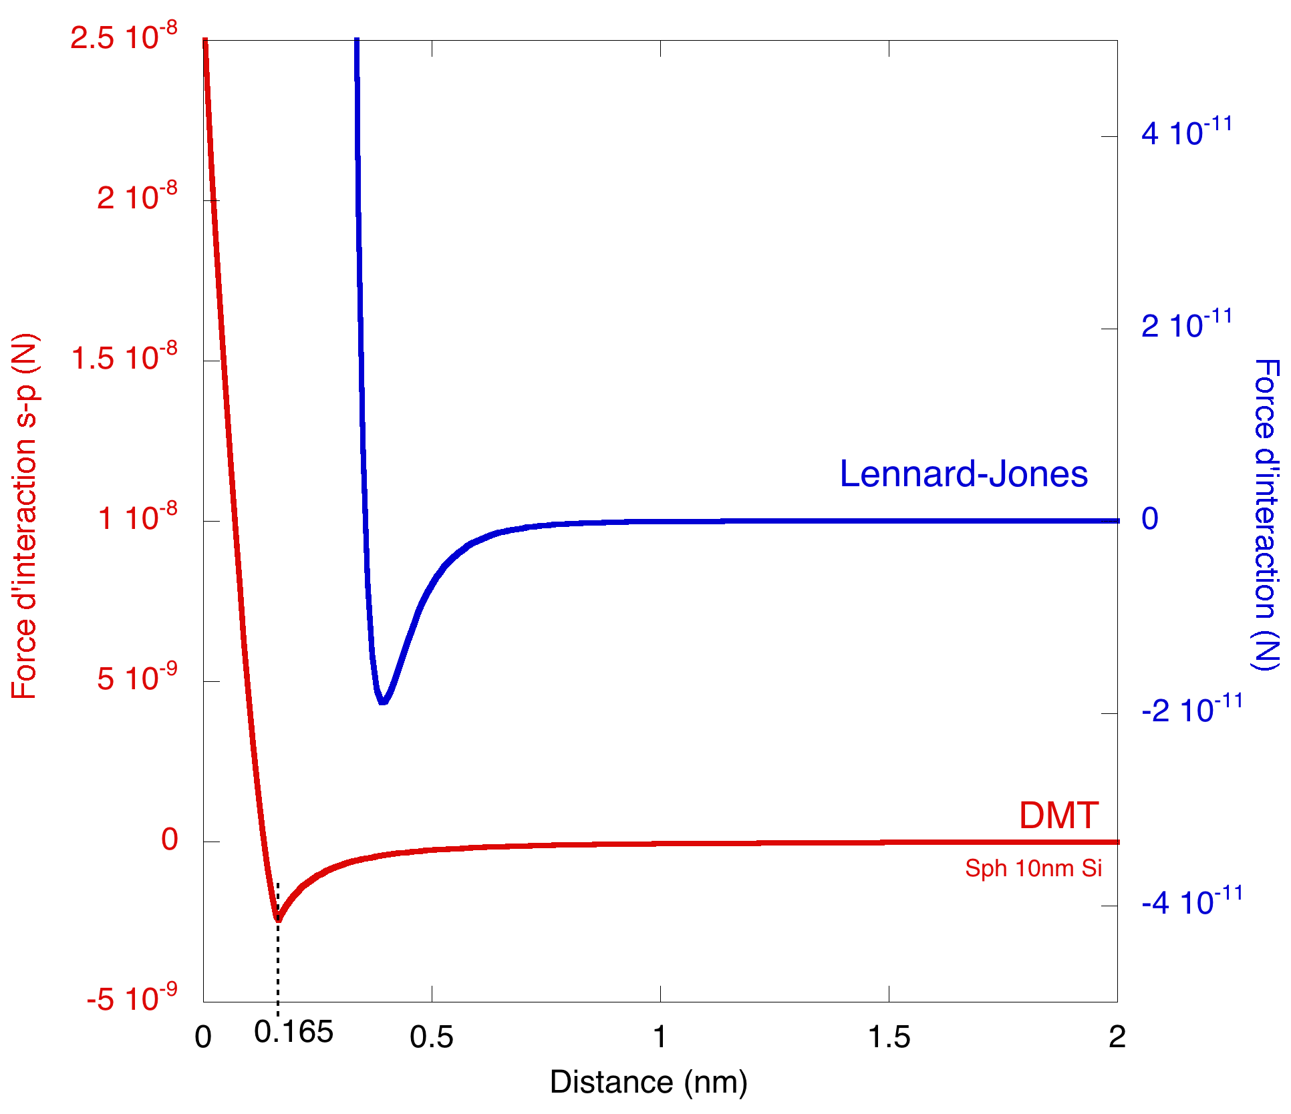
II. Tip-surface interaction
Si-Si

Slide 15
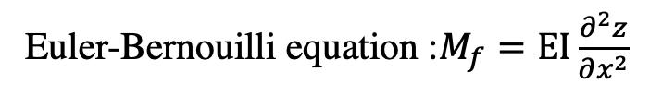

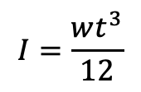
III. Interaction force detection
III. Interaction force detection
A) Use of a cantilever to feel the force
z
L
x
t
F
w
Bending moment :$M_{f}=−F\left(x−L\right)$
Euler-Bernouilli equation :$M_{f}=EI\frac{∂^{2}z}{∂x^{2}}$
E, Young’s modulus of the cantilever
I, area moment of inertia of the cantilever cross section
$$I=\frac{wt^{3}}{12}$$

Slide 16
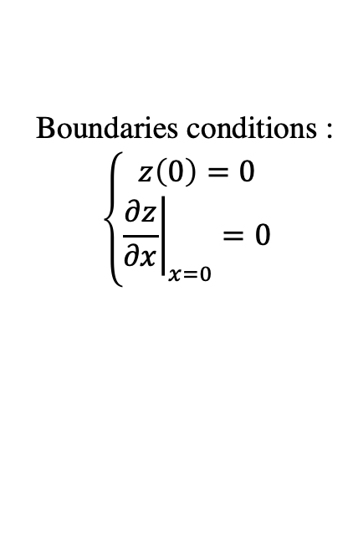
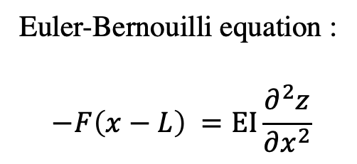
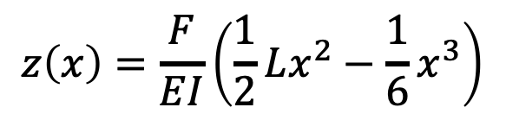
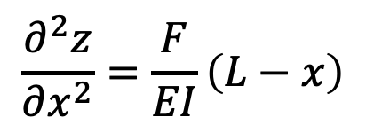
III. Interaction force detection
z
L
x
Euler-Bernouilli equation :
$$−F\left(x−L\right) =EI\frac{∂^{2}z}{∂x^{2}}$$
F
Boundaries conditions :
$$\left\{\begin{aligned}z\left(0\right)=0 \\ {\left.\frac{∂z}{∂x}\right|}_{x=0}=0\end{aligned}\right.$$
$$\frac{∂^{2}z}{∂x^{2}}=\frac{F}{EI}\left(L−x\right)$$
$$z\left(x\right)=\frac{F}{EI}\left(\frac{1}{2}Lx^{2}−\frac{1}{6}x^{3}\right)$$

Slide 17

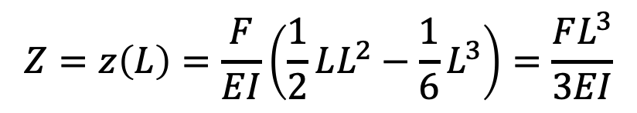
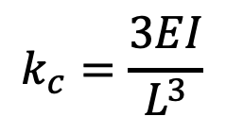
III. Interaction force detection
z
B) Deflection measurement
L
x
Z
Deflection Z, is the flexure at the end of the cantilever.
F
$$Z=z\left(L\right)=\frac{F}{EI}\left(\frac{1}{2}LL^{2}−\frac{1}{6}L^{3}\right)=\frac{FL^{3}}{3EI}$$
$$F=k_{c}Z$$
(Hooke’s law)
with k_{c} the stiffness of the cantilever
$$k_{c}=\frac{3EI}{L^{3}}$$

Slide 18
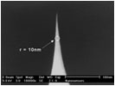
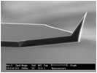
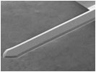
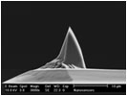
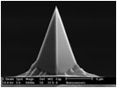
III. Interaction force detection
Si Cantilever
400-500 µm
Tapping mode
High resolution
contact | L=450 µm | k=0.1 N/m | f = 6 kHz
tapping | L=225 µm | k=40 N/m | f= 150 kHz
Pour le mode contact
Apex curvature radius 10 nm
10µm

Slide 19
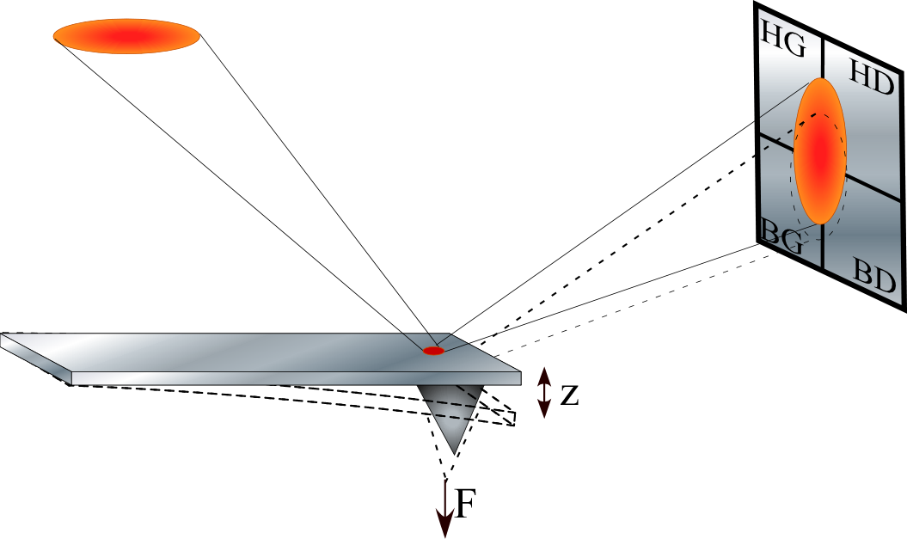
III. Interaction force detection
Optical detection of the force
Laser diode
photodiode
cantilever

Slide 20
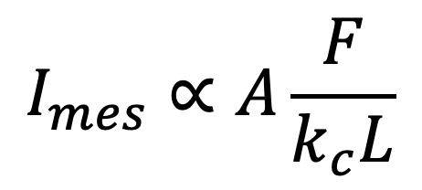
III. Interaction force detection
B) Deflection measurement
$$I_{mes}∝A\frac{F}{k_{c}L}$$
I_{top}
+
HG
HD
I_{mes}=I_{top}-I_{bottom}
-
BG
HD
+
photodiode
I_{bottom}
F
F

Slide 21
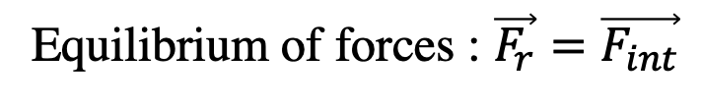



IV. Static mode
A) Force curve
PiezoZ
x
$$D_{z}=D+Z$$
Z
F_{r}
D
F_{int}
D_{z}
Equilibrium of forces : $\vec{F_{r}}=\vec{F_{int}}$
$$−k_{c}Z=F^{s−p}(D)$$
$$−k_{c}\left(D_{z}−D\right)=F^{s−p}(D)$$
Line with k_{c} slope
DMT curve

Slide 22
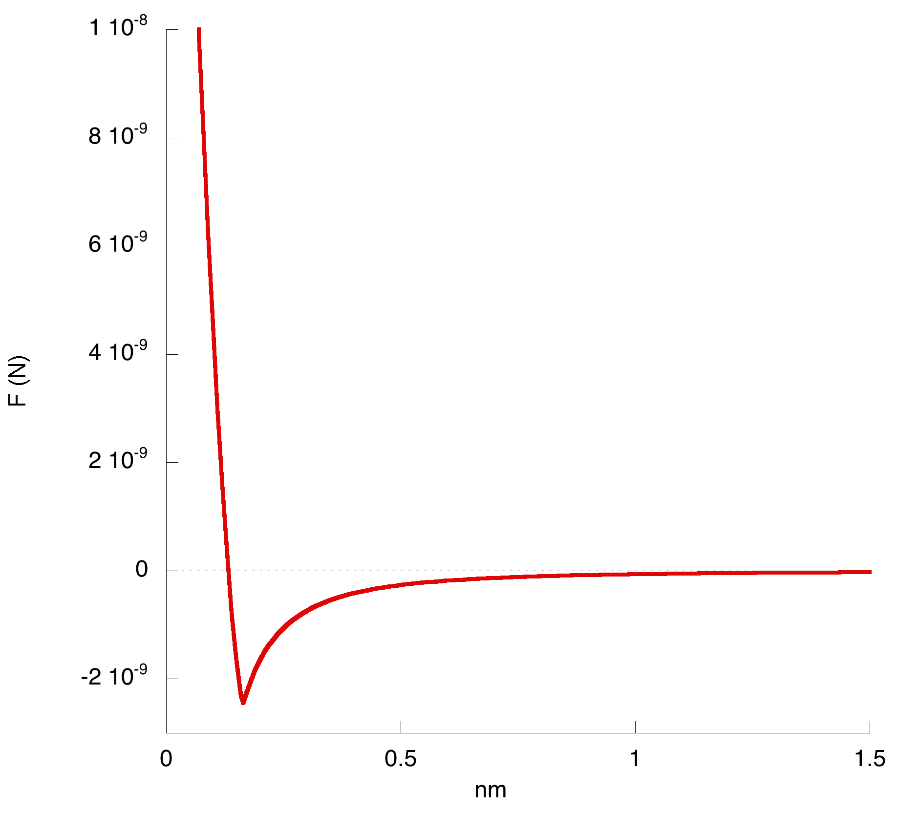
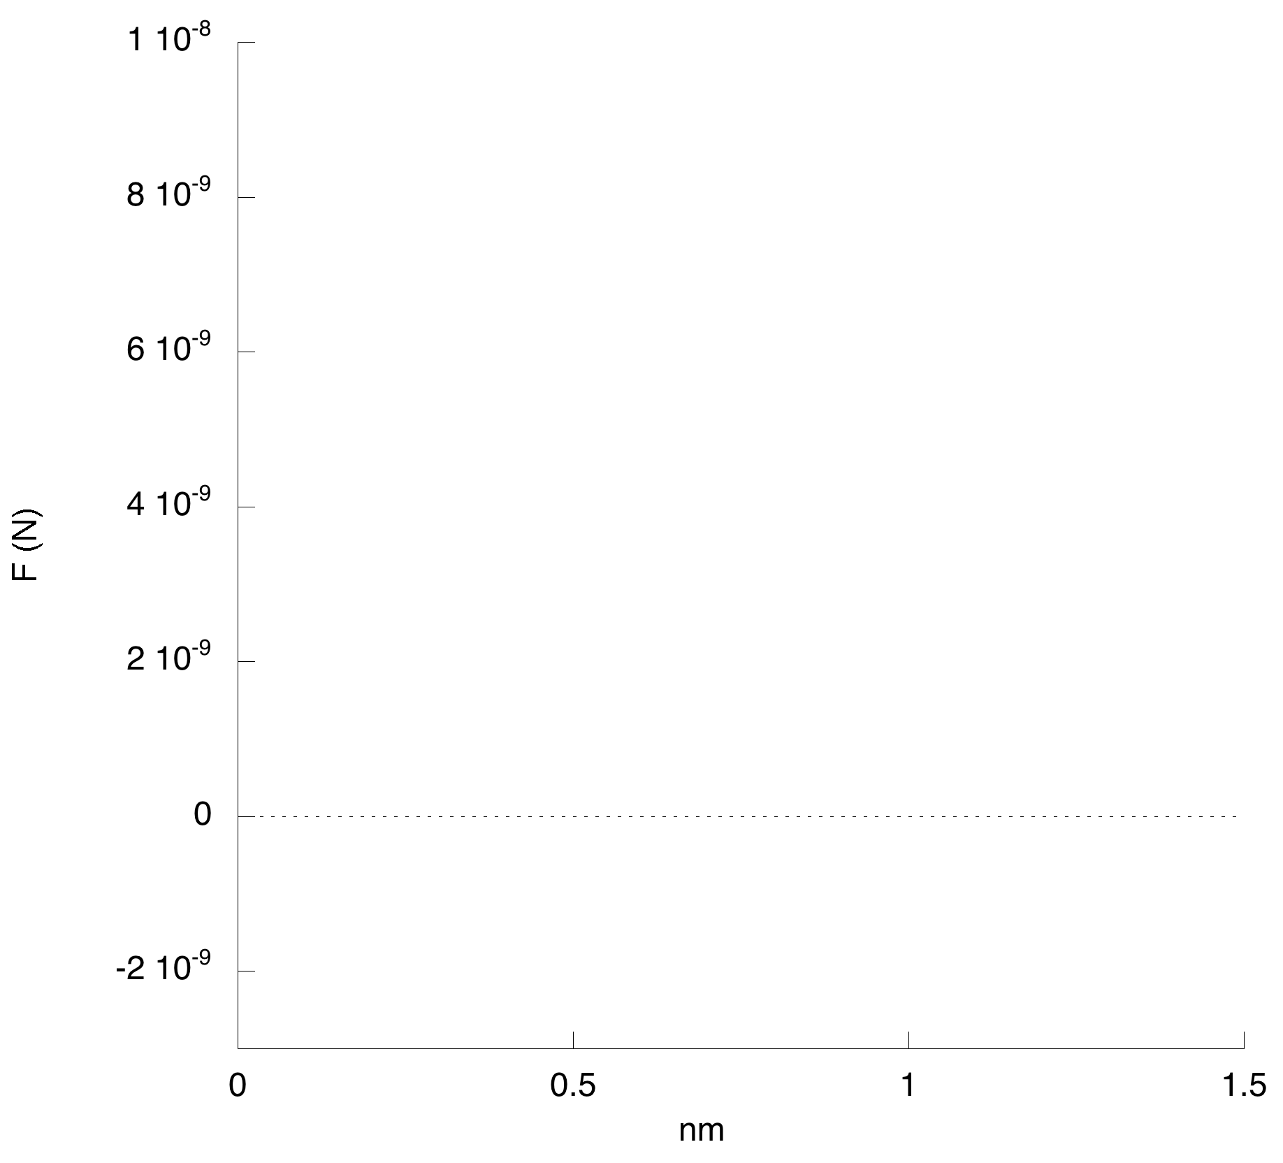
IV. Static mode
Force curve F(D_{z})
piezoZ
F^{s-p}
approach
D_{z}^{E}
E
D_{z}^{D}
D_{z}^{C}
D_{z}^{B}
D_{z}^{A}
retract
D
C
B
A
D’
C’
B’
D
E
C
B
D
A
D’
C’
B’
D_{z}

Slide 23
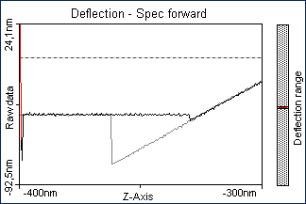
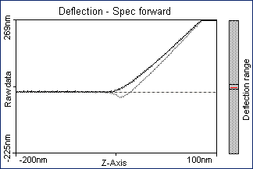
IV. Static mode
Force curveF(D_{z})
On hard surface
Force curve F(D_{z})
On soft surface

Slide 24
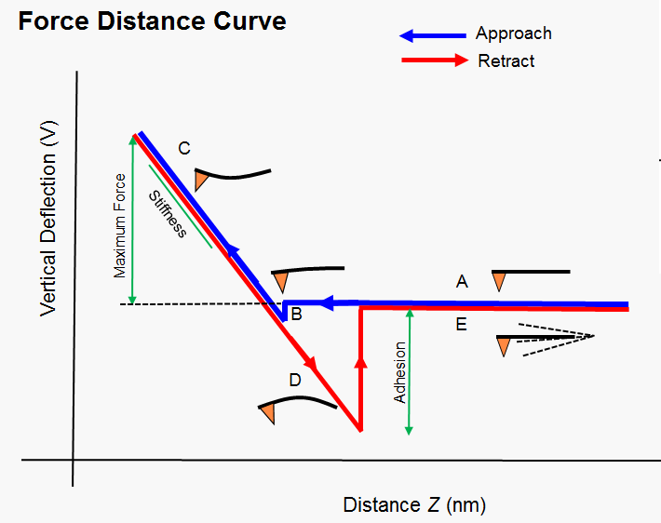
IV. Static mode

Slide 25
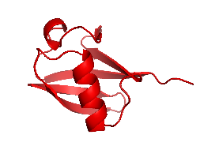
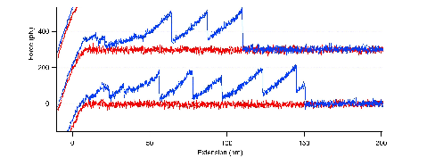
IV. Static mode
Application : Spectroscopy of single protein
Ubiquitin

Slide 26
IV. Static mode
B) Imaging mode
PiezoXY
PiezoZ
x
D_{z}
PiezoZ actuator : surface approach
PiezoXY actuators : scan of the surface in XY plane
Surface scanning:
Approach
Scanning X and Y
Y
Top view
F
X

Slide 27
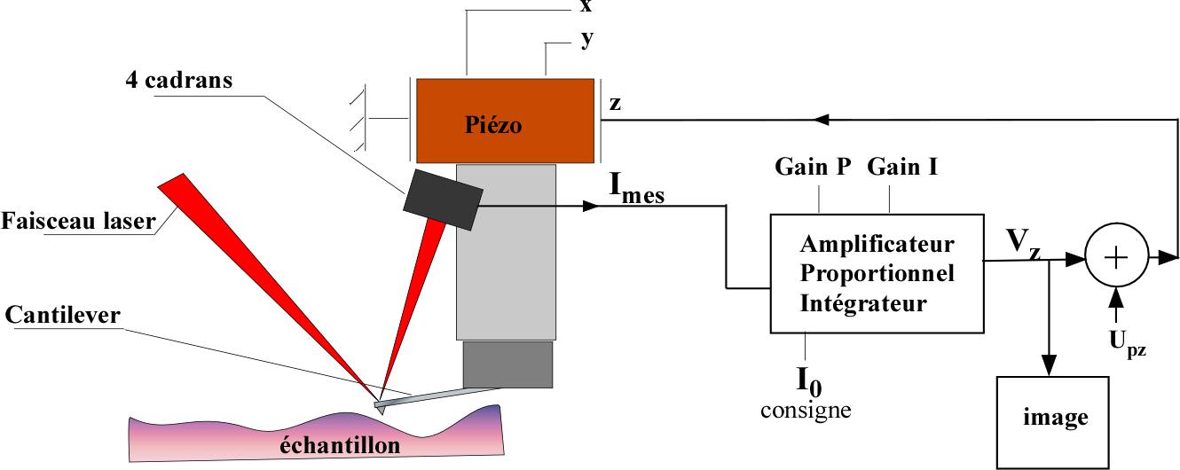
IV. Static mode
Constant force Imaging
4 quadrants
piezo
(F)
Laser diode
PI controller
(F₀)
setpoint
sample

Slide 28
IV. Static force
Modelling force constant imaging (F₀)
F
B
F₁
A
τ
F₀
τ
F₂
h
D_{B}
D_{A}
D_{z}
B
h
τ
τ
A
D_{z}
D_{B}
h’=D_{A}-D_{B}
D_{A}
F
F₁
F₀
F₂

Slide 29
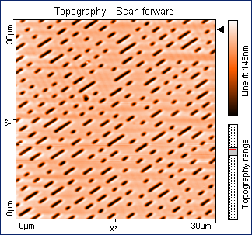
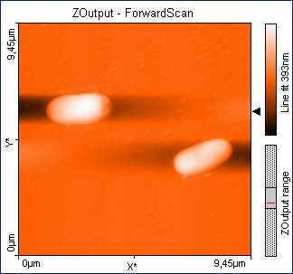
IV. Static force
Contact mode images

Slide 30
V. Dynamic mode (tapping)
PiezoXY
Amplitude
PiezoZ
ω
Piezo drive
x
Signal generator
D_{z}
PiezoZ actuator : surface approach
PiezoXY actuators : scan of the surface in XY plane
Piezo drive : select the cantilever frequency of oscillation
Advantage : soft and fragile sample imaging
(no more shear effect during the scan)

Slide 31
AFM image
CONTACT MODE
AFM image
TAPPING MODE

Slide 32
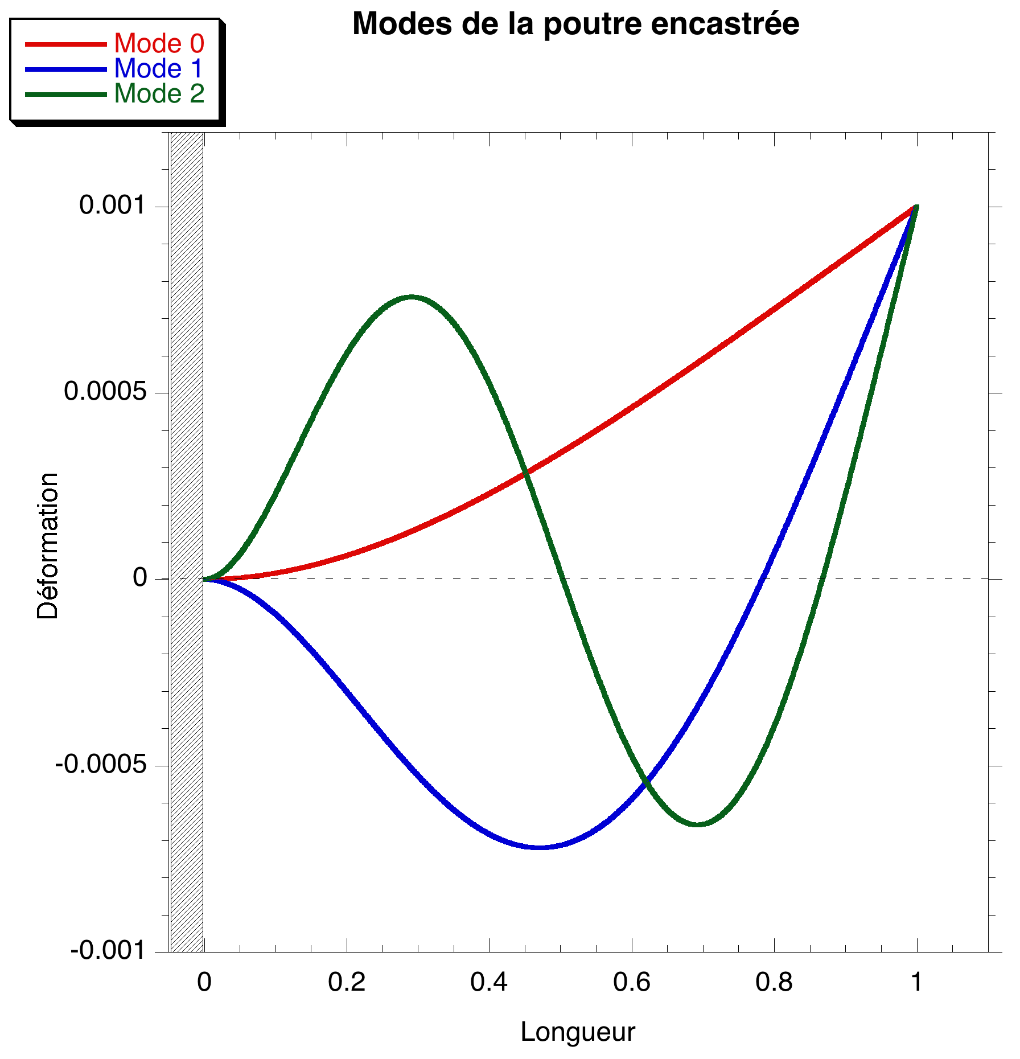
V. Dynamic mode
A) Cantilever modes
Euler-Bernouilli equation :
Solution :
with
and
frequency
damping

Slide 33

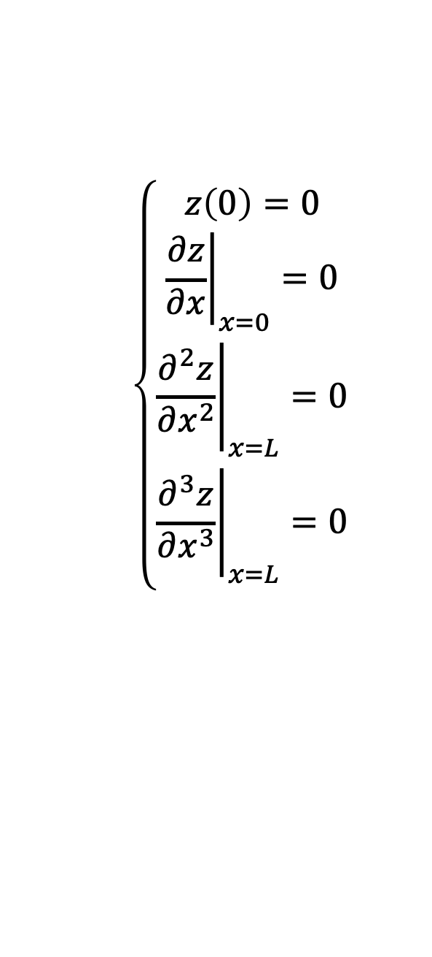
V. Dynamic mode
Euler-Bernouilli equation :
z
L
Boundaries conditions :
x
$$\left\{\begin{matrix}z\left(0\right)=0 \\ {\left.\frac{∂z}{∂x}\right|}_{x=0}=0 \\ \begin{matrix}{\left.\frac{∂^{2}z}{∂x^{2}}\right|}_{x=L}=0 \\ {\left.\frac{∂^{3}z}{∂x^{3}}\right|}_{x=L}=0\end{matrix}\end{matrix}\right.$$
Eigenvalues (modes) equation of the cantilever :
$$1+cos\left(βL\right)cosh\left(βL\right)=0$$
Mode n | β_{n}L
0 | 1.8750
1 | 4.6941
2 | 7.8547

Slide 34
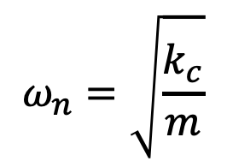
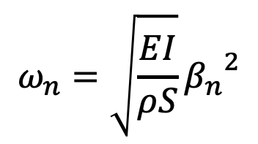
V. Dynamic mode
Dispersion equations
cantilever
mass-spring
z
L
x
Z
Z
$$ω_{n}=\sqrt{\frac{EI}{ρS}}{β_{n}}^{2}$$
$$ω_{n}=\sqrt{\frac{k_{c}}{m}}$$
E, Young’s modulus of the cantilever
I, area moment of inertia of the cantilever cross section
S, cross section : S=wt
ρ, cantilever density
k_{c}, spring constant
m, mass

Slide 35
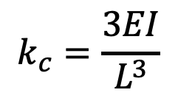
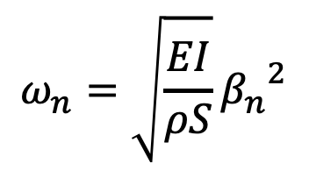



V. Dynamic mode
Cantilever parameters :
$$ω_{n}=\sqrt{\frac{EI}{ρS}}{β_{n}}^{2}$$
$$k_{c}=\frac{3EI}{L^{3}}$$
$$m=ρSL$$
Each mode can be described by the mass-spring model.
$$ω_{n}=\sqrt{\frac{k_{c}L^{3}}{3ρS}}{β_{n}}^{2}=\sqrt{\frac{k_{c}}{3m}}{β_{n}}^{2}L^{2}=\sqrt{\frac{k_{c}}{{m_{n}}^{∗}}}$$
Where m_{n}* is the mass of the mode
$${m_{n}}^{∗}=\frac{ 3m}{{\left(β_{n}L\right)}^{4}}$$
Mode n | m_{n}*
0 | 0.24267 m
1 | 0.00618 m
2 | 0.00079 m

Slide 36


V. Dynamic mode
B) Motion equation of cantilever modes.
Z
x
$$\frac{∂^{2}Z_{n}}{∂t^{2}}+Γ\frac{∂Z_{n}}{∂t}+{ω_{n}}^{2}=0$$
$$ω_{n}=\sqrt{\frac{k_{c}}{{m_{n}}^{∗}}}$$
where
, Γ damping, and Z_{n} the deflection of teh n^{th} modes

Slide 37


V. Dynamic mode
C) Motion equation of cantilever driven by a piezo.
Z
ω
Piezo drive
x
Signal generator
$$\frac{∂^{2}Z_{n}}{∂t^{2}}+Γ\frac{∂Z_{n}}{∂t}+{ω_{n}}^{2}=\frac{F_{pz}}{{m_{n}}^{∗}}e^{iωt}$$
$$ω_{n}=\sqrt{\frac{k_{c}}{{m_{n}}^{∗}}}$$
where
, Γ damping, and Z_{n} the deflection of teh n^{th} modes, F_{pz} force applied by the piezo

Slide 38







V. Dynamic mode
$$\frac{∂^{2}Z_{n}}{∂t^{2}}+Γ\frac{∂Z_{n}}{∂t}+{ω_{n}}^{2}=\frac{F_{pz}}{{m_{n}}^{∗}}e^{iωt}$$
Solution : $Z\left(t\right)=\tilde{A}\left(ω\right)e^{iωt}$
$$−ω^{2}\tilde{A}+iω\tilde{A}Γ+{ω_{n}}^{2}\tilde{A}=\frac{F_{pz}}{{m_{n}}^{∗}}$$
$$\tilde{A}\left(ω\right)=\frac{1}{{m_{n}}^{∗}}\frac{F_{pz}}{{ω_{n}}^{2}−ω^{2}+iωΓ}$$
Solution : $Z\left(t\right)=ρ\left(ω\right)e^{i\left(ωt+φ\left(ω\right)\right)}$
$ρ\left(ω\right)=$ $\frac{1}{{m_{n}}^{∗}}\frac{F_{pz}}{\sqrt{{\left({ω_{n}}^{2}−ω^{2}\right)}^{2}+Γ^{2}ω^{2}}}$
$$φ=\tan^{−1}\left(\frac{Γω}{ω^{2}−{ω_{n}}^{2}}\right)$$

Slide 39


V. Dynamic mode
Exemple of 1rst mode of a cantilever
Amplitude(ρ)
Phase(ϕ)

Slide 40

V. Dynamic mode
D) Motion equation of cantilever driven by a piezo and in interaction with the surface.
piezoZ
Z
ω
Piezo drive
x
Signal generator
D_{z}
F_{int}
non linear term
$$\frac{∂^{2}Z_{n}}{∂t^{2}}+Γ\frac{∂Z_{n}}{∂t}+{ω_{n}}^{2}=\frac{F_{pz}}{{m_{n}}^{∗}}e^{iωt}+\frac{F_{int}\left(D_{z}−Z_{n}\right)}{{m_{n}}^{∗}}$$
$$ω_{n}=\sqrt{\frac{k_{c}}{{m_{n}}^{∗}}}$$
where
, Γ damping, and Z_{n} the deflection of teh n^{th} modes, F_{pz} force applied by the piezo

Slide 41


V. Dynamic mode
Principle of least action (or principle of stationary action)
L is the Lagrangian of the mechanical system and defined by :
$$L=T−U$$
where T is the kinetic energy and U potential energy
S is the action defined as :
$$S=\int_{t_{1}}^{t_{2}}{L\left(\dot{z},z,t\right)dt}$$
where t₁ and t₂ are 2 different times corresponding at 2 different positions of z.

Slide 42


V. Dynamic mode
The principle of least action is :
$$δS=0 or \frac{∂S}{∂X_{i}}=0$$
where X_{i} is the variables of the system
For a conservative system the equation of motion is found by :
$$\frac{d}{dt}\left(\frac{∂L}{∂\dot{z}}\right)−\frac{∂L}{∂z}=0$$

Slide 43

V. Dynamic mode
Principle of least action in our case can be expressed as :
$$L\left(z,\dot{z},t\right)=\frac{1}{2}m^{∗}\dot{z}{\left(t\right)}^{2}−\left[\frac{1}{2}k_{c}z{\left(t\right)}^{2}−z\left(t\right)F_{pz}cos\left(ωt\right)+U_{int}\right]−Γm^{∗}z\left(t\right)\underline{\dot{z}\left(t\right)}$$
Kinetic energy
potential energy
of the spring
Potential energy
of tip-surface interaction
potential energy
of the piezo
dissipation energy from the damping
Stationary solution can be written like :
$$z\left(t\right)=Acos\left(ωt+φ\right)$$
variables of the system

Slide 44





V. Dynamic mode
We can rewrite the action as 3 different parts :
$$S=S_{0}+S_{dissip}+S_{int}$$
where the action is calculated over a period of oscillation
$S_{0}=\int_{0}^{\frac{2π}{ω}}{\left(\frac{1}{2}m^{∗}\dot{z}{\left(t\right)}^{2}−\frac{1}{2}k_{c}z{\left(t\right)}^{2}+z\left(t\right)F_{pz}cos\left(ωt\right)\right)}$dt
$S_{dissip}=\int_{0}^{\frac{2π}{ω}}{Γm^{∗}z\left(t\right)\underline{\dot{z}\left(t\right)}}$dt
$S_{int}=\int_{0}^{\frac{2π}{ω}}{U_{int}}$dt
$$\left\{\begin{aligned}\frac{∂S}{∂A}=0 \\ \frac{∂S}{∂φ}=0\end{aligned}\right.$$
Principle of least action tell us :

Slide 45






V. Dynamic mode
Equation becomes:
$$\left\{\begin{aligned}cosφ=\frac{m^{∗}}{F_{pz}}A\left({ω_{0}}^{2}−ω^{2}\right)−\frac{ω}{πF_{pz}}\frac{∂S_{int}}{∂A} \\ sinφ=−\frac{{Γm}^{∗}}{F_{pz}}ωA\end{aligned}\right.$$
$$ω_{0}=\sqrt{\frac{k_{c}}{{m_{n}}^{∗}}}$$
Pure attractive interaction
Pure repulsive interaction
$$S_{int}=−\int_{0}^{\frac{2π}{ω}}{\frac{HR}{6{\left(D−Acos\left(ωt+φ\right)\right)}^{2}}dt}$$
$$S_{int}=−k_{s}\int_{0}^{τ}{{\left(Acos\left(ωt+φ\right)−D\right)}^{2}dt}$$
k_{s} is contact spring constant
τ time of contact
$$\frac{∂S_{int}}{∂A}=\frac{HRπ}{3ω}\frac{A}{{\left(D^{2}−A^{2}\right)}^{3/2}}$$
$$\frac{∂S_{int}}{∂A}=−\frac{4\sqrt{2}}{3}\frac{k_{s}D}{ω}{\left(\frac{A}{D}−1\right)}^{3/2}$$

Slide 46









V. Dynamic mode
Resonance of the mode
Pure attractive interaction
$$u_{±}=\sqrt{\frac{1}{a^{2}}−\frac{1}{4Q^{2}}{\left(1±\sqrt{1−4Q^{2}\left(1−\frac{1}{a^{2}}−\frac{κ_{nc}}{3{\left(d^{2}−a^{2}\right)}^{3/2}}\right)}\right)}^{2}}$$
Pure repulsive interaction
$$u_{±}=\sqrt{\frac{1}{a^{2}}−\frac{1}{4Q^{2}}{\left(1±\sqrt{1−4Q^{2}\left(1−\frac{1}{a^{2}}+\frac{4\sqrt{2}}{3π}κ_{c}{\left(1−\frac{d}{a}\right)}^{3/2}\right)}\right)}^{2}}$$
$$u=\frac{ω}{ω_{0}}$$
$$d=\frac{D}{A_{0}}$$
$$a=\frac{A}{A_{0}}$$
$$Q=\frac{ω_{0}}{Γ}$$
$$κ_{c}=\frac{k_{s}}{k_{c}}$$
$$κ_{nc}=\frac{HR}{k_{c}{A_{0}}^{3}}$$
$$A_{0}=ρ\left(ω_{0}\right)$$

Slide 47


V. Dynamic mode
Resonance behavior in function of the tip-surface distance
Attractive interaction
Repulsive interaction

Slide 48

V. Dynamic mode
E) Approach-retract curve
Z$\left(t\right)=A\left(ω\right)cos\left(ωt+φ\left(ω\right)\right)$
piezoZ
Z(t)
ω
Piezo drive
x
Signal generator
approach
D_{z}
F_{int}
retract
For a fixed ω (slightly off the resonance), analysis of Amplitude A(ω) and phase ϕ(ω) of the cantilever during the approach (increase of D_{z}) and retract (decrease of D_{z}).

Slide 49




V. Dynamic mode
Attractive interaction
$$\left\{\begin{aligned}cosφ=Qa\left(1−u^{2}\right)−\frac{aQκ_{nc}}{3{\left(d^{2}−a^{2}\right)}^{3/2}} \\ sinφ=−ua\end{aligned}\right.$$
surface
Amplitude of cantilever
$$\begin{matrix}d_{±}=\sqrt{a^{2}+{\left(\frac{Qκ_{nc}}{3\left(Q\left(1−u^{2}\right)∓\sqrt{1/{a^{2}−u^{2}}}\right)}\right)}^{2/3}} \\ φ_{±}=\tan^{−1}\left(\frac{u}{Q\left(u^{2}−1\right)+\frac{Qκ_{nc}}{3{\left({d_{±}}^{2}−a^{2}\right)}^{3/2}}}\right)\end{matrix}$$
Phase of the cantilever

Slide 50




V. Dynamic mode
Repulsive interaction
$$\left\{\begin{aligned}cosφ=Qa\left(1−u^{2}\right)+\frac{4\sqrt{2}}{3π}Qκ_{c}a{\left(1−\frac{d}{a}\right)}^{3/2} \\ sinφ=−ua\end{aligned}\right.$$
surface
slope=1
Amplitude of cantilever
$$\begin{matrix}d=a\left(1−{\left(\frac{3π}{4\sqrt{2}}\frac{Q\left(u^{2}−1\right)+\sqrt{1/{a^{2}−u^{2}}}}{Qκ_{c}}\right)}^{2/3}\right) \\ φ=\tan^{−1}\left(\frac{u}{Q\left(u^{2}−1\right)−\frac{4\sqrt{2}}{3π}Qκ_{c}{\left(1−\frac{d}{a}\right)}^{3/2}}\right)\end{matrix}$$
Phase of the cantilever

Slide 51


V. Dynamic mode
Modelling the amplitude and phase for different surface contact
Amplitude
Phase
κ=300
κ=0.3
κ=0.03
κ=0.003

Slide 52
IV. Dynamic mode
F) Imaging mode
PiezoXY
PiezoZ
Z(t)
ω
Piezo drive
x
Signal generator
D_{z}
PiezoZ actuator : surface approach
PiezoXY actuators : scan of the surface in XY plane
Surface scanning:
Approach
Scanning X and Y
Y
Top view
X

Slide 53

V. Dynamic mode
Constant amplitude imaging (tapping)
4 quadrants
piezoXYZ
Laser diode
PI controller
lockin
Setpoint (A_{w}/A₀)
sample

Slide 54
IV. Dynamic mode
Tapping mode operation :
1) Use a cantilever for tapping mode with the first mode frequency around 70kHz-400kHz.
2) Detecting of the resonance of mode. Measurement of the Amplitude in function of the frequency of the piezo driver.
3) Selecting the working frequency (A_{free})
4) Selecting the setpoint for imaging (A_{w}/A₀)
5) Approaching the surface until reaching the setpoint (A_{w}/A₀)
6) Scan in X and Y axis keeping the amplitude constant (setpoint) recording the variation of V_{z} as the topography image

Slide 55
IV. Dynamic mode
Tapping mode imaging
PiezoXY
PiezoZ
A_{free}
ω
Piezo drive
PiezoXY
PiezoXY
Topography image (V_{z})
PiezoZ
PiezoXY
ω
A_{w}
PiezoZ
Piezo drive
PiezoZ
A
ω
ω
A_{w}
Piezo drive
Piezo drive

Slide 56

IV. Dynamic mode
Image AFM en mode dynamique
ADN (100nm x 100 nm)

Slide 57



VI. Resolution
Tip effect example

Slide 58
VI. Resolution
A) Vertical sensitivity
Goes to 30pm to 300pm, strongly dependent on the AFM system,
vibration isolation table and environment.
B) Lateral resolution
Strongly dependent on the AFM system and the tip radius:
can go from sub-nanometer up to 10 nm resolution

Slide 59
OTHER AFM OPERATING MODES

Slide 60



AFM in fluid
Contact and tapping mode
Yeast spore into a membrane (10µm x 10µm)
Force-Volume analysis
Blood cells (tapping)
Other AFM operating modes

Slide 61

Identification and location of a protein on bacterial membrane
@ DOI 10.1002/sca.20177
Other AFM operating modes

Slide 62

Force-volume imaging
Figure 2. Imaging the dynamic clustering of cell-adhesion proteins on the surface of a living cell. (A) Single C. albicans adhesins were localized and stretched on different locations of a single yeast cell using an AFM tip bearing specific antibodies. (B) Molecular recognition map record- ed on a cell that was never probed, thus not subjected to force. Coloured pixels document the detection of single proteins (the blue and red pixels correspond to forces in the 0–150 pN and 150–300 pN range, respectively). Most proteins were isolated and evenly distributed, without any clear evidence for clustering. (C) Subsequent recognition map recorded on a remote area of the same cell following application of force. Proteins in the second map were no longer isolated but clustered into nanodomains referred to as ‘nanoadhesomes’. Reprinted with permission from Alsteens, D. et al. (2010).
@Current Biology vol21 n6 R212, D.D Müller, Y.F. Dufrêne
Other AFM operating modes

Slide 63

Force-volume imaging
High-resolution force–volume AFM of the extracellular PM surface. a) Topography. Inset of (a) shows three-fold symmetrized cross-correlation average (n = 200) of the bacteriorhodopsin (BR) trimer. Outlined BR shapes (white lines with the seven transmembrane α-helices A–G indicated) were obtained from X-ray and electron crystallographic analyses.[15b] Full color scales correspond to vertical ranges of a) 1.0 nm. Scale bars, 10 nm (raw data) and 2 nm (insets).
@ DOI: 10.1002/anie.201103991
Other AFM operating mode

Slide 64

Tapping mode in fluid
Conformational changes of proteins (streptavidin) and DNA observed in buffer solution. (a) The hexagonally packed intermediate (HPI) layer consists of hexameric units having a central core and connecting arms. At the inner surface, the cores exhibit a central pore that occurs in‘open’ (unplugged) and ‘closed’ (plugged) conformations. Repeated imaging of the same surface at 4-min intervals showed that some pores changed their conformation. This conformational change was fully reversible and could be observed over long time periods. The defective pore at the bottom left corner is used as a reference to align the scans. The images were recorded in 100 mM KCl, 20 mM
MgCl2, 10 mM Tris, pH 8.2, using the contact mode. Bar, 15 nm. Shades correpond to a height range of 6 nm. (b) Atomic force microscope images of plasmid DNA. This plasmid contains a 106-bp inverted repeat, which is stabilized in the cruciform conformation by negative DNA supercoiling. Arrows indicate the cruciforms. The frames from the left to right are four repetitive scans over the same area. The hairpin arms of the indicated cruciform were initially quite far away from each other (with an angle of ~1008), but then they moved closer and finally adopted a parallel orientation. The scanning was performed in Tris–EDTA buffer with a NanoScope III MultiMode system (Digital Instruments, Inc., Santa Barbara, CA, USA) operating in the tapping mode. Bar, 40 nm.
@trends in CELL BIOLOGY (Vol. 9) February 1999
Other AFM operating modes

Slide 65



Fluorescence imaging and AFM
Other AFM operating modes

Slide 66


Nanolithography and nanomanipulation
Gold nanoparticles manipulation (8nm)
Nanoindentation (15 nm)
in polymer film
(800nm x 800 nm)
Other AFM operating modes

Slide 67


Nanomechanical imaging
Tapping phase imaging of copolymer
@https://doi.org/10.1021/la0005098
Other AFM operating modes

Slide 68
PeakForce Tapping
@https://doi.org/10.1021/acs.langmuir.5b02595
Other AFM operating modes

Slide 69



EFM (Electric Force Microscope)
Applications in nanoelectronics
Transistor default detected by EFM
(80µm x 80 µm)
EFM images for 2 inverted polarisation
(15µm x 15 µm)
Other AFM operating modes

Slide 70


MFM (Magnetic Force Microscope)
Double pass imaging
topography
MFM image
Hard disk surface
Other AFM operating modes

Slide 71



SThM (Scanning Thermal Microscope)
AFM thermal probe
topography
Thermal conductivity image
Sample of glass fibers into epoxy matrix.
Other AFM operating modes

Slide 72


Coupling AFM/STM in high vacuum
@H. Le Sueur. Cryogenic AFM-STM for mesoscopic physics. Condensed Matter. Université Pierre et Marie Curie - Paris VI, 2007.
Other AFM operating modes

Slide 73

AFM-IR : coupling AFM with IR spectroscopy
IR laser
Other AFM operating modes

Slide 74











Field of applications - Biology
TISSUE – Human cells
MICRO-ORGANISMS
NANOMETRIC SCALE
Accumulation of biopolymer or lipids
Protein assemblies
Calcification in human tissues
Extracellular vesicles
Penetration of nanocarriers
Localisation and quantification
Collagen fibrils denaturation
System complex: Collagen-antibiotic
Local composition, TAG, DAG, MAG and FFA differentiation
Bacterial amyloids
Beta structure of amyloids
Prion, lipids bilayer
Nanoparticules and cell: macrophage
Fine structure of the hair…

Slide 75










Field of applications
Polymers sciences
Heritage sciences
Nanoparticles
Multilayers:
Structure-cristallinity
- Polymeric Nps
- Investigate parchments degradation
Mathurin J., 10.1039/C8AN01239C, Analyst, 2018
A Dazzi, Chem Rev, 2016
G.Latour, Scientific Report, 2016
- IR signatures: heterogeneities in ancient tissues or violin sections
Astrochemistry
- Investigation of organic matter in micrometeorites
Trace of adjuvant blooming
A Dazzi, International journal of pharmaceutics Volume 484, Issues 1–2, 2015
J. Mathurin, A&A, 2019
Notes:
Mettre les références des différentes images
Beside

